Slide 1










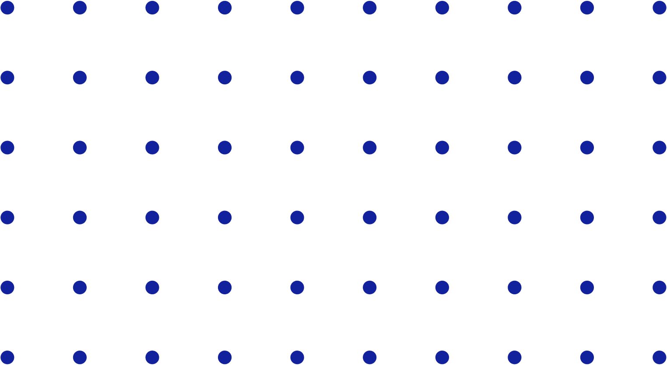
Group Number
Predictive Modelling for Real Estate Prices
Supervision by: Rahul Pradhan
Himanshu
Naman
Akshit
Piyush

Slide 2



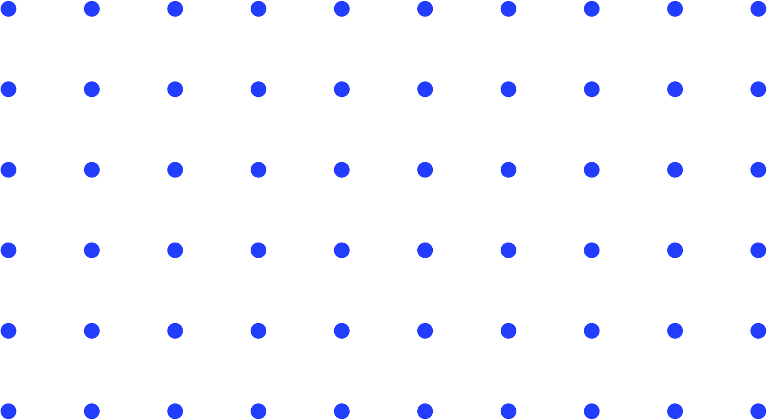

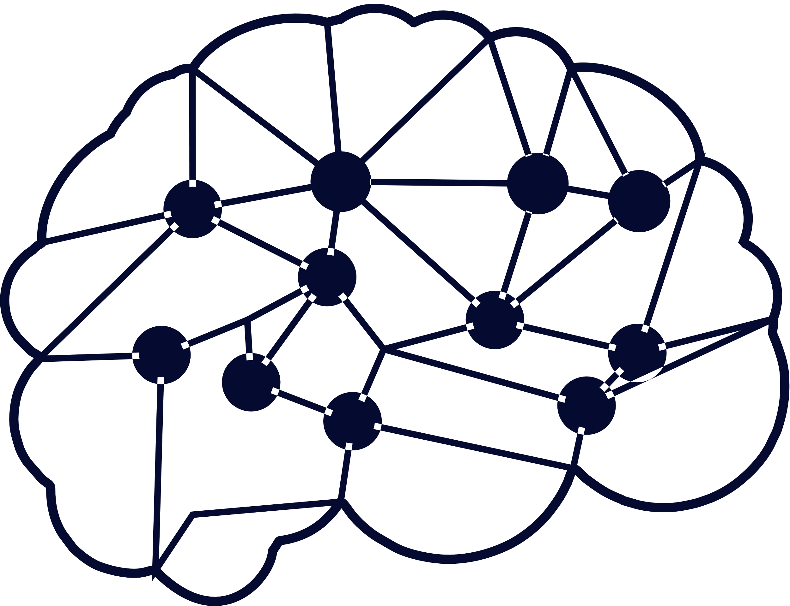
Index of Presentation
Introduction
Proposed Methodology
Architecture
01
Introduction
04
Factors affecting real estate prices
02
05
Experiments and results
03
Proposed Methodology
06
Conclusion & Future Work
07
References

Slide 3







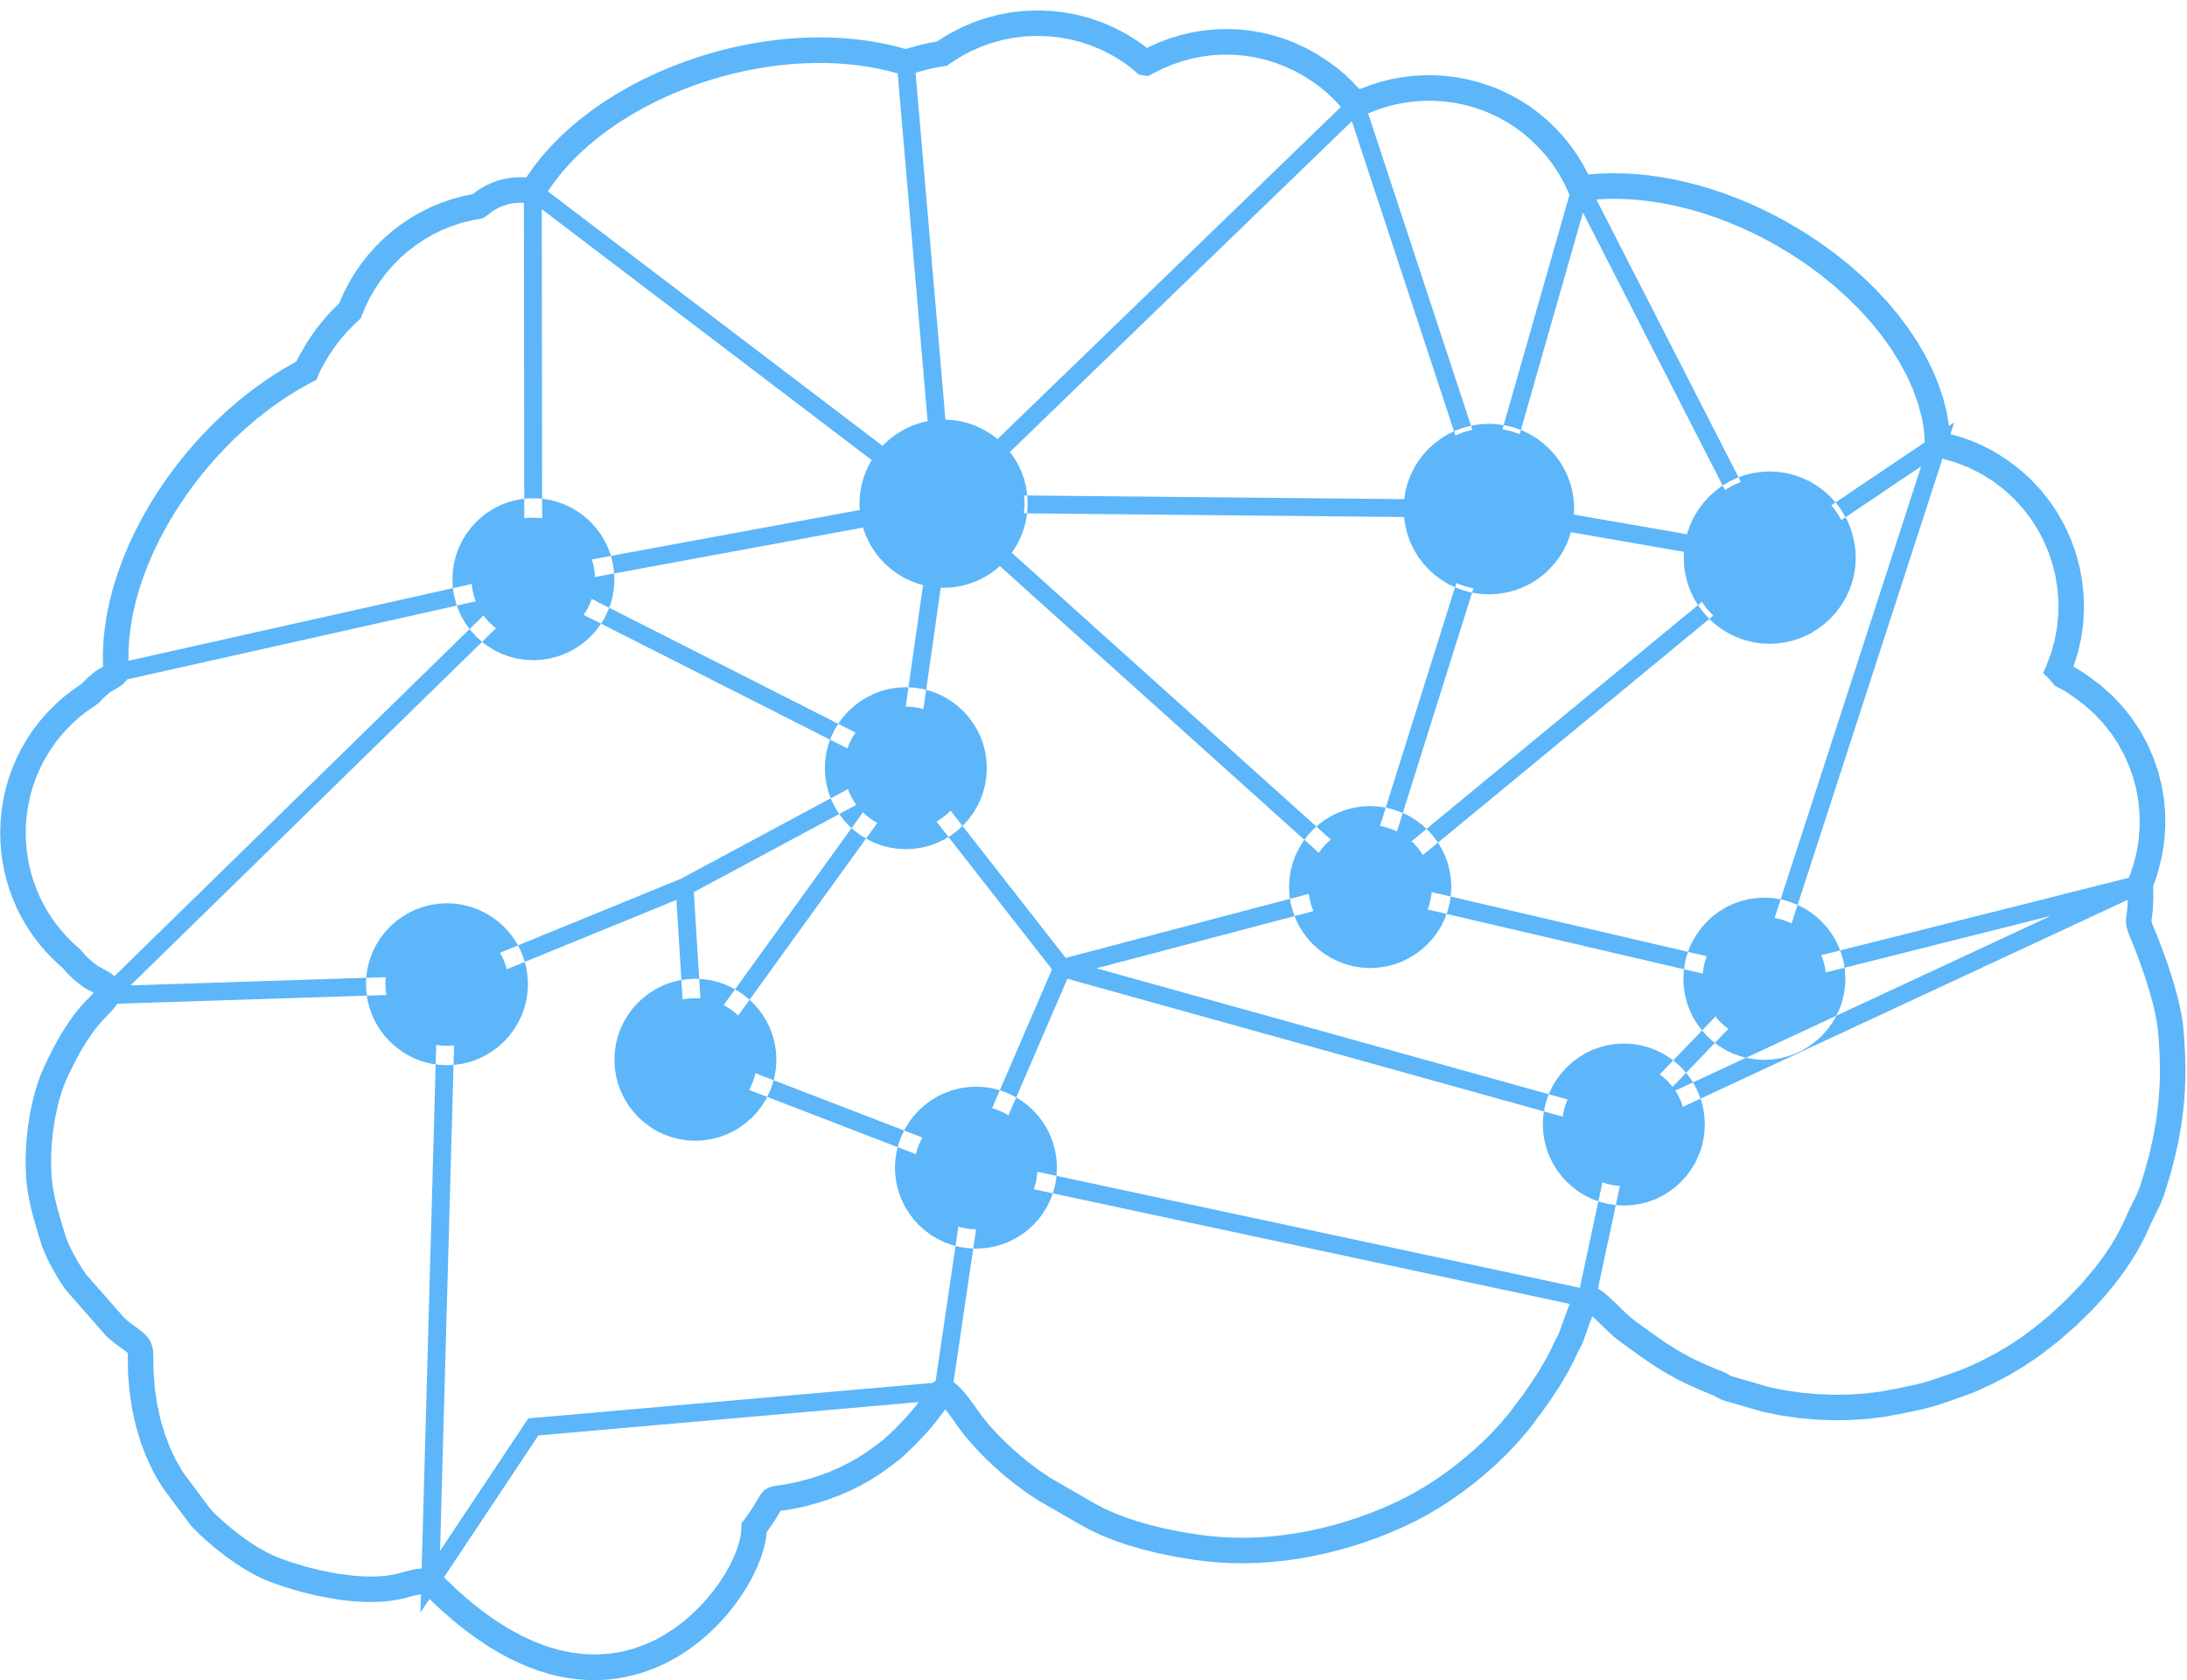
Introduction
Predictive modeling is a process of using statistical and machine learning techniques to analyze data and make predictions about future events or trends.
Model uses Hybrid approach combining neural networks , KNN and linear regression and using Flask to render it on an front-end page..
In the context of real estate, predictive modeling is used to analyze historical data on properties and their prices, and then use that analysis to predict future prices.
Our goal is to develop a machine learning algorithm to analyze the housing dataset and based on certain parameters it should predict the price of that particular estate.

Slide 4





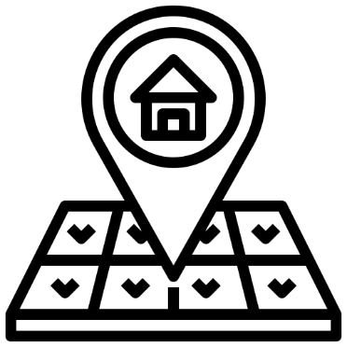
Factors affecting the Real estate prices
Number of Rooms
Distance
Bathroom
Year built
Land size

Slide 5




Proposed Methodology
Data Collection
Data Preprocessing
Feature Selection
Model Training
Model Evaluation
Model Deployment

Slide 6
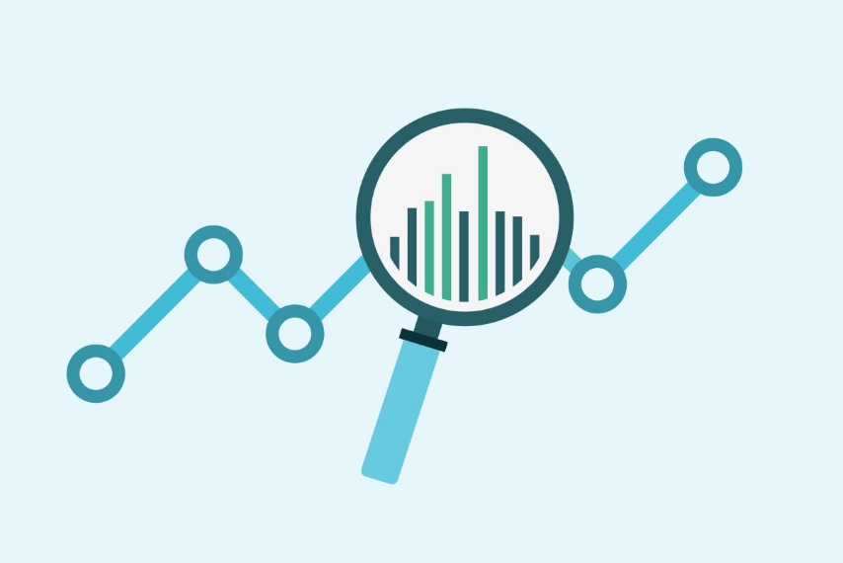
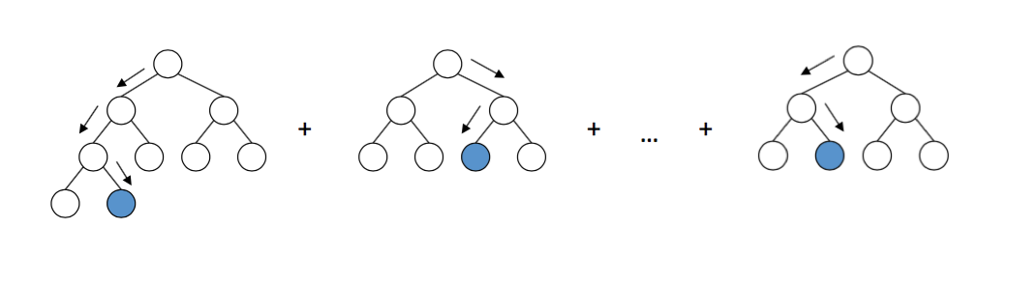
Proposed Methodology Architecture
Data ading
Decision Tree Classifier
Random Forest Classifier
Metrics Analysis
Gradient Boost Classifier
Data Preprocessing

Slide 7

Discussion on Proposed Methodology
Data Collection
Model Training
Collection of data on properties and prices.
The model is then trained using various ML algos such as regression, decision trees, or neural networks.
Data Cleaning and Preprocessing
Model Deployment
Now the model is finally deployed using pickle & Flask in our particular case.
This involves removing any duplicate or irrelevant data, filling in missing values, and encoding categorical variables.
Model Evaluation
Model is now evaluated to ensure the accuracy and reliability. This involves metrics such as mean squared error , mean absolute error, or R-squared to assess the model’s performance

Slide 8
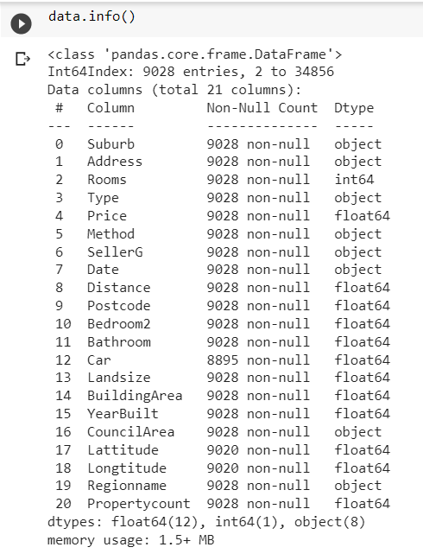
Melbourne Housing Full Dataset
The Melbourne Housing Market dataset is a real estate dataset that can be used for supervised learning problems such as regression or classification. The dataset contains 35,000 instances of properties sold in Melbourne, Australia between January 2016 and December 2018, and 21 features, including both categorical and numerical variables.
The target variable of the dataset is 'Price', which represents the price of the property in Australian dollars. The remaining features can be used as input variables to predict the target variable. For example, the features 'Rooms', 'Type', 'Distance', 'Bedroom2', 'Bathroom', 'Car', 'Landsize', 'BuildingArea', 'YearBuilt', 'CouncilArea', 'Lattitude', and 'Longtitude' can be used to predict the price of a property.

Slide 9
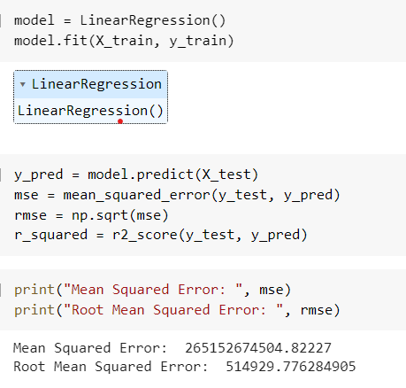
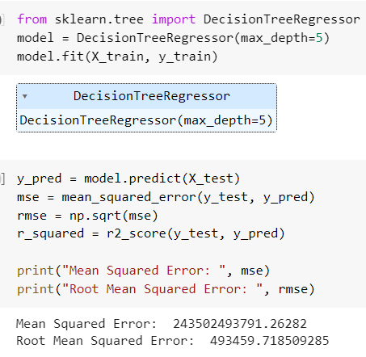
Linear Regression / Decision Tree Regressor

Slide 10
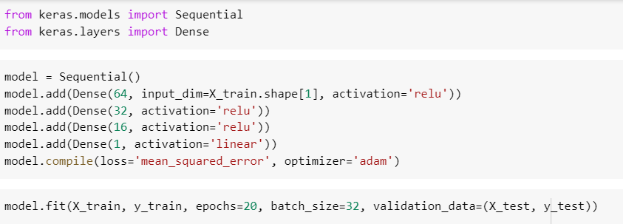
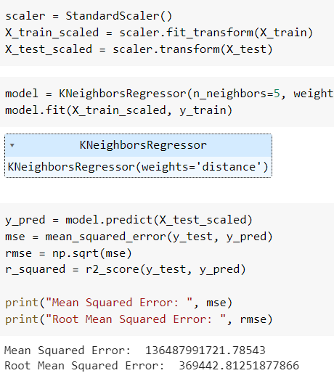
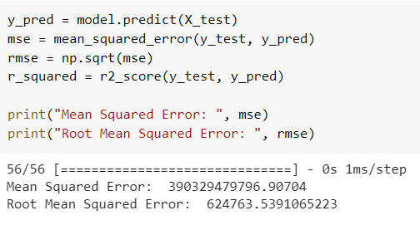
Neural Network / KNRegressor

Slide 11
Hybrid KNRegressor Neural Network Model
Why?
After implementing 4 different ML Algorithms we have found that these two algorithms are giving better results. So, we decided to combine these 2 models and develop the hybrid model.
The Model
The hybrid KNN and neural network model is a machine learning algorithm that combines the strengths of two popular techniques to improve the accuracy and efficiency of predictions. The KNN algorithm is simple and efficient, while neural networks have powerful learning capabilities.
This hybrid model works by first using the KNN algorithm to identify the K-nearest neighbors to a new data point. The data points are then passed to a neural network for further processing. The neural network can be customized to fit the specific problem and data being analyzed.
The output of the neural network is used as the final prediction for the new data point. This hybrid approach provides accurate predictions while still being computationally efficient.

Slide 12
Flask & Pickle
Flask is a lightweight and popular web framework for Python. It allows you to quickly and easily build web applications by providing a simple and intuitive interface. Flask is known for its flexibility and ease of use, making it a popular choice for small to medium-sized web applications. It also has a large and active community, with many third-party extensions available to add extra functionality.
Pickle is a built-in Python module that allows you to serialize and deserialize Python objects. Serialization is the process of converting an object into a format that can be stored or transmitted, while deserialization is the reverse process of reconstructing the object from the serialized form.
To use Flask and Pickle together, you would first need to import the Pickle module into your Flask application. You could then use the dump() function to serialize your Python object, and the load() function to deserialize it.

Slide 13
Experiments and Results
Data Set Description with Reference:
Our datatset contains several columns determining
the features of any house and land.
System Description:
Goal of our model is to successfully predict the
prices of land depending on few parameters.
Result:
Successfully implemented hybrid model
combining KNeighbours Regressor and Neural
Network to predict the price of any House.

Slide 14
Conclusion and Future Work
Summary
01
In general the predictive model more than 90% accuracy is not very common on any large data.
03
We can further add more models in our combined model to enhance the prediction.
02
The predictive power of the models can be improved by using additional features and preprocessing those features.
Features which are not being considered in making the model.
04
We can enhance our WebApp and can provide free service, so that people can get estimation of pricing based on some defined parameters.

Slide 15
References
[1] Kaggle
[2] GeeksForGeeks
[3] GitHub
[4] StackOverflow
[5] Wikepedia
[6] Youtube
[7] Python Documentaion

Slide 16




Any Queries

Slide 17
Thank You

